Slide 1


Analysis of Wine Quality Dataset
Vaishnavi S

Slide 2


Contents
Most frequently occurring wine quality and max & min value of sales
Correlation of various attributes with the wine quality
Avg. residual sugar in the best & lowest quality wine
Correlation b/w volatile acidity & quality
Training a decision tree and random forest classifier model and comparing the accuracy

Slide 3

Q1. Most frequently occurring wine quality and max & min value of sales
The most frequently occurring value of wine quality is 5. The highest quality value is 8. The lowest quality value is 3.

Slide 4
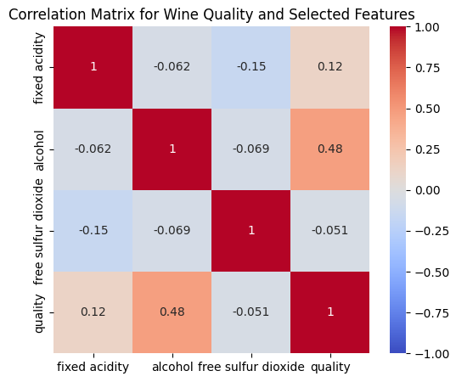
Q2. Correlation of various attributes with the wine quality

Slide 5
Analysis
The correlation between Fixed Acidity and Quality is 0.12. This indicates a positive, but very weak correlation between these two features, suggesting that the Fixed Acidity does not have a strong impact on the overall wine quality.
The correlation between Alcohol and Quality is 0.48, indicating that the alcohol content in a wine has a substantial positive effect on the quality. An increase in the alcohol level can lead to an increase in the quality.
The correlation between Free Sulphur Dioxide and Quality is -0.051, which shows a negative relationship between the two feature. The Free Sulphur Dioxide content in a wine adversely affects its quality.
Thus, a wine should have more amount of alcohol and acidity and less free sulphur dioxide.

Slide 6
Q3. Avg. residual sugar in the best & lowest quality wine

Slide 7
Analysis
The difference between the residual sugar levels in the best and lowest quality wine is negligible. Thus, one might say that the Residual Sugar feature has a minimal impact on the quality.
However, the slight difference between the average level suggests that good quality wines have lesser sugar than the lower quality ones.

Slide 8
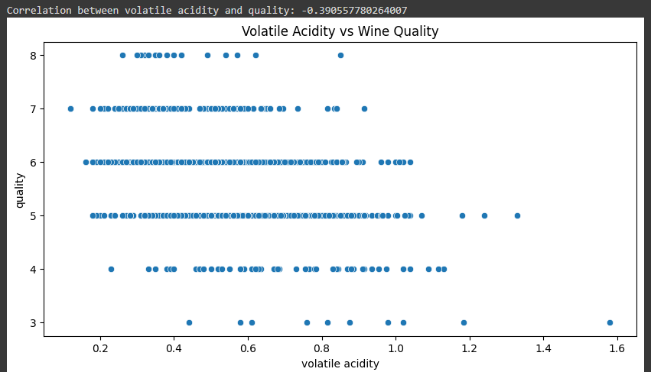
Q4. Correlation b/w volatile acidity & quality

Slide 9
Analysis
The correlation between Volatile Acidity and Wine quality is -0.3905. This shows a moderate negative correlation, that implies an adverse effect the volatile acidity has over the quality.
Thus, it is necessary for wine makers to ensure that they maintain low levels of volatile acidity, to create high quality wines.

Slide 10


Q6. Training a decision tree and random forest classifier model and comparing the accuracy
Decision Tree Random Forest Classifier

Slide 11
Steps involved
Separating the predictor and target variables
Splitting the dataset into training and test set
Scaling the split datasets
Training the model (Decision Tree/Random Forest Classifier)
Predicting the values of the test set
Plotting a confusion matrix
Obtaining the accuracy score

Slide 12
Analysis
Both models show moderate accuracy, with Random Forest performing better than Decision Tree.
Random Forest reduces overfitting by averaging multiple decision trees, which likely leads to better generalization and the slight improvement in accuracy.
The Random Forest's higher accuracy shows it is a better choice than Decision Tree for this dataset.
However, both the models have a scope for improvement.

Slide 13
Thank You

